Slide 1
MIS 6326.002 Project Presentation – Uber
Anthony Sung
Dipsa Prusty
Rony Joseph
Sumana Narayan Reddy

Slide 2

Background
Uber is an online transportation network company whose primary product is the development and operation of its Uber software which allows consumers to request car transportation via its mobile app.
Notes:
Why we chose uber –
An app that all of us use.
We considered lyft but went with Uber because of its popularity in the area

Slide 3
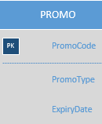
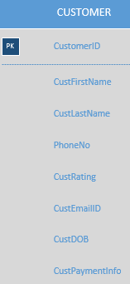
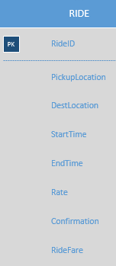
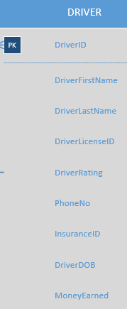
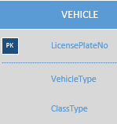
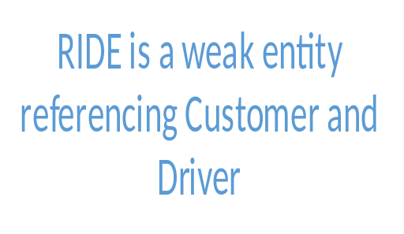
ERD – 5 Entities
Notes:
Quick Overview of our entities
Promo code may be applied to a customer zero to M
Customer books ride 1 – M
Driver Accepts 1-M rides
Driver drives M-N vehicles

Slide 4
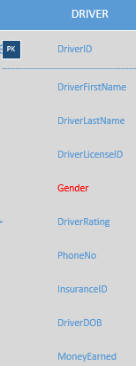
ERD New Feature – Choosing Driver Gender
Customers may select gender of driver
Customers may also select driverless cars as an option
Gender has three options of M, F, and R
Notes:
We were inspired by Uber in India where female customers wanted to be able to drive safely with female drivers so we added Gender to the Driver Entity.
Genders are M, F, R (robot for autonomous driverless vehicles).
In the future, may technologists believe driverless cars will be an option.
Uber and other companies will likely offer promotions to get people to try driverless vehicles.
Since gender is an additional field to the driver entity, there were not significant changes to the ERD.

Slide 5
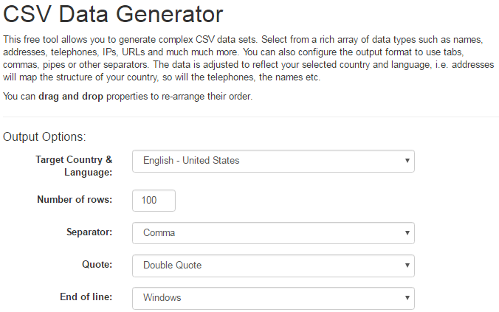
Generating Data
http://www.freedatagenerator.com/csv-data-generator
25 Drivers
30 Customers
80 Rides
5 Promo Codes
30 Vehicles
Notes:
One of the most difficult parts of our project.
Talked to a professional and he even stated the same thing.

Slide 6

Scenario 1 Queries and Results
Number of customers who selected driverless cars:
SELECT gender, COUNT(customer.CUSTOMER_ID) AS g_count
FROM ride
JOIN customer ON ride.CUSTOMER_ID=customer.CUSTOMER_ID
JOIN driver ON driver.DRIVER_ID=ride.DRIVER_ID
WHERE gender='R' GROUP BY gender
Notes:
Let’s start with our new feature and selecting number of rides taken with a driverless car
This was our randomly generated data set. Over our lifetimes I believe fewer and fewer people will be driving cars in the future
And I’m sure uber would want nothing less than an entire fleet of driverless cars. Don’t have to pay the drivers.

Slide 7
Scenario 2 Queries and Results
Full name of customer who had the most rides with the same driver (full name):
SELECT driver.DRIVER_ID, driver.FIRSTNAME AS driver_firstname, driver.LASTNAME AS driver_lastname, customer.CUSTOMER_ID,customer.FIRSTNAME AS customer_firstname, customer.LASTNAME AS customer_lastname , NoOfRides
FROM customer, driver
(SELECT driver_id,CUSTOMER_ID ,COUNT(ride_id) as NoOfRides from ride
GROUP BY driver_id,customer_id
ORDER by noofrides DESC limit 1) AS tbl1
WHERE customer.CUSTOMER_ID = tbl1.customer_id
AND driver.DRIVER_ID = tbl1.driver_id
Notes:
Interesting to see if customers get the same driver
Nested join

Slide 8
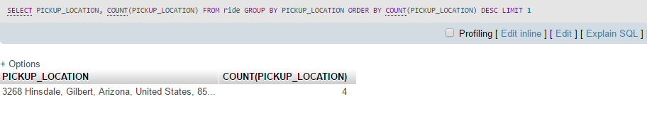
Scenario 3 Queries and Results
Most popular pick-up location
SELECT PICKUP_LOCATION,
COUNT(PICKUP_LOCATION)
FROM ride
GROUP BY PICKUP_LOCATION ORDER BY COUNT(PICKUP_LOCATION) DESC LIMIT 1
Notes:
This scenario retrieves the data for most popular pick up location

Slide 9

Questions

